Slide 1
Candidate evaluation for He3 + He4 in ENDF/B-VIII.1/beta1
Review for INDEN-LE
Ian Thompson
Nuclear Data and Theory Group
Feb 13, 2023

Slide 2
R-matrix Framework
Strategy:
The calculations should be made using B_{c} = −L_{c}
Background levels at 20 MeV (in this basis), 1 per spin group
Maximum orbital angular momentum L_{ah}^{max} = 4, L_{pLi}^{max} = 1, and all the spin groups up to J^{π} = 9/2±.
R-matrix channel radii determined as a = 1.4 [fm] (A₁^{1/3}+A₂^{1/3}) and the same for all channels within a particle pair.
No capture channels yet
Most emphasis on h+α cross sections up to about 12 MeV: the data.

Slide 3
Specifying Experiment Data for the Be7 system
Use *.dat files from de Boer, converted to ⁴He on ³He lab data.
Still need to specify properties of these files:
There are many errors in the EXFOR descriptions of these data sets.
projectile | ejectile | residual | file | sys-error | stat-error | norm | group | splitnorms | lab | abserr | scale | filedir | eshift | ecalib | splitshifts
a | a | 0 | Barnard_aa.dat | 5 | 3 | 1 | E | FALSE | TRUE | TRUE | b | Expt5/ | 0 | 0 | FALSE
p | a | 0 | Elwyn_pa.dat | 9 | -1 | 1 | A | FALSE | TRUE | TRUE | b | Expt5/ | 0 | 0 | FALSE
p | p | 0 | Fasoli_pp.dat | -1 | 1.5 | 1 | E | TRUE | TRUE | TRUE | b | Expt5/ | 0 | 0 | FALSE
p | p | 0 | Harrison_pp0.dat | -1 | 2 | 2.2 | A | FALSE | TRUE | TRUE | b | Expt5/ | 0 | 0 | FALSE
p | p | 1 | Harrison_pp1.dat | -1 | -1 | 0.2 | A | FALSE | TRUE | TRUE | b | Expt5/ | 0 | 0 | FALSE
p | a | 0 | Lin_pa.dat | 10 | -1 | 1 | A | TRUE | TRUE | TRUE | b | Expt5/ | 0 | 0 | FALSE
p | p | 0 | McCray_pp.dat | 5 | -1 | 1 | E | TRUE | TRUE | TRUE | b | Expt5/ | 0 | 0 | FALSE
a | a | 0 | Mohr_aa.dat | -1 | 5 | 1 | A | TRUE | TRUE | TRUE | b | Expt5/ | 0 | 0 | FALSE
a | a | 0 | Spiger-A1094004-lab_aa.dat | 1.5 | -1 | 1 | E | TRUE | TRUE | TRUE | b | Expt5/ | 0 | 0.02 | TRUE
a | p | 0 | Spiger-cm_ap0.dat | 1.5 | -1 | 1 | A | TRUE | FALSE | TRUE | mb | Expt5/ | 0 | 0 | FALSE
a | a | 0 | Tombrello_aa.dat | 5 | -1 | 1 | E | FALSE | TRUE | TRUE | b | Expt5/ | 0 | 0.02 | TRUE
a | h | 15 | LIMIT | 4.001506 | 3.01550116
p | Li6 | 2.79 | LIMIT | 1.008665 | 6.01347726
Correct some data:
The 9.106 MeV point at 36.999 deg in the Spiger_aa data is not extracted from the plots properly.
The Tombrello_aa data (not A1039 but A1295) should have a constant discretization error of 0.5 mb/sr added in quadrature to the per-cent errors for the A1295002 data.
The points in Elwyn_pa at Ep = 2.277, 2.377, and 2.476 MeV were not plotted correctly, if checked by Legendre data.

Slide 4
Search adventures
The bound states should be at the observed Be7 energies, but that will not happen exactly since we are using the B=-L boundary conditions. So I ended up constraining the Brune-basis bound states at observed energy within 0.02 MeV.
I ended up adding in some broad 3/2+ and 5/2+ poles lower than our 20 MeV background pole set.
The amplitudes for the background poles were highly correlated in the final fit (ρ > 0.995). Since, strictly, these are not physical observables, I ended up fixing many of them, and only varying the norms and the middle-pole properties in order to obtain the final covariance matrix.
I always plot the phase shifts, on a fine energy grid, from the final parameters: to make sure no unwanted poles have crept in.
It is probable that the Spiger_aa elastic data is 0.1 MeV too high in its energy calibration. I fitted also the energy calibration of Spiger_aa and Tombrello_aa.

Slide 5

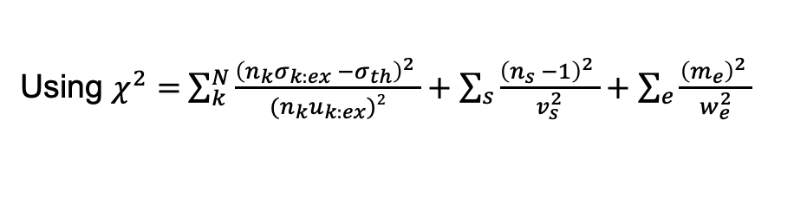
Results of fit
I get χ²/N = 2.884 from the data, and χ²/N = 3.037 overall including contributions from norm factors differing from unity and shifts differing from zero.
m
Dataset | Chisq/pts | av norm | av shift
Barnard_aa.dat | 0.967 | 0.990
Elwyn_pa.dat | 4.317 | 1.133
Fasoli_pp.dat | 3.895 | 0.996
Harrison_pp0.dat | 5.489 | 1.156
Lin_pa.dat | 3.885 | 1.305
McCray_pp.dat | 3.842 | 1.122
Mohr_aa.dat | 3.481 | 0.956
Spiger-A1094004-lab_aa.dat | 2.633 | 0.929 | -0.048
Spiger-cm_ap0.dat | 1.419 | 1.004
Tombrello_aa.dat | 3.559 | 1.080 | -0.036
Notations
$k$ = identifies experimental result
$σ_{k:ex}$ = experimental result
$u_{k:ex}$ = experimental point uncertainty
$σ_{th }$= theory model
$n_{s}$ = systematic scale factor
$v_{s}$ = expt. listed systematic uncertainty
$m_{e}$ = systematic energy shift
$w_{e}$ = expt. listed energy uncertainty
We assume that the experimental point uncertainties also scale with $n_{k}$.
Point scaling factors $n_{k}$ are grouped according to experimental systematics into
angular or energy-dependent scaling $n_{s}.$
Using $χ^{2}=$ $\sum_{k}^{N}{\frac{{\left(n_{k}σ_{k:ex} −σ_{th}\right)}^{2} }{{(n}_{k}u_{k:ex})2}}+\sum_{s}{\frac{{\left(n_{s} −1\right)}^{2} }{v_{s}^{2}}}+\sum_{e}{\frac{{\left(m_{e}\right)}^{2} }{w_{e}^{2}}}$

Slide 6
Fitted R-matrix parameters

Slide 7
Brune Basis
183 parameters and 226 fitted data sets
Spin-parity groups with no poles: [(3.5, 1), (4.5, -1), (4.5, 1)]
J,pi=1.5- from -12.669 to -3.682 took 31 iterations (cm: -5.444 to -1.582)
J,pi=1.5- from 31.955 to 19.747 took 60 iterations (cm: 13.732 to 8.486)
J,pi=1.5- from 46.542 to 39.136 took 6 iterations (cm: 20.000 to 16.817)
J,pi=0.5- from -38.193 to -2.641 took 278 iterations (cm: -16.412 to -1.135)
J,pi=0.5- from 46.542 to 39.743 took 6 iterations (cm: 20.000 to 17.078)
J,pi=3.5- from -29.086 to 6.924 took 523 iterations (cm: -12.499 to 2.975)
J,pi=3.5- from 46.542 to 24.676 took 18 iterations (cm: 20.000 to 10.604)
J,pi=2.5- from 14.511 to 11.713 took 48 iterations (cm: 6.236 to 5.033)
J,pi=2.5- from 16.426 to 13.016 took 262 iterations (cm: 7.058 to 5.593)
J,pi=2.5- from 46.542 to 19.809 took 38 iterations (cm: 20.000 to 8.512)
J,pi=0.5+ from 46.542 to 40.740 took 9 iterations (cm: 20.000 to 17.507)
J,pi=1.5+ from 29.641 to 18.132 took 268 iterations (cm: 12.737 to 7.792)
J,pi=1.5+ from 46.542 to 25.829 took 22 iterations (cm: 20.000 to 11.099)
J,pi=2.5+ from 36.075 to 15.979 took 358 iterations (cm: 15.502 to 6.866)
J,pi=2.5+ from 46.542 to 30.270 took 12 iterations (cm: 20.000 to 13.008)
constrained energies in red
Incident ⁴He lab energies
CM energies
in ⁴He+³He channel

Slide 8
⁴He + ³He diagonal phase shifts
Only 3 resonances in entrance channel:
1 in 7/2-
2 in 5/2-
Hint of 5/2+ pole
(no resonance)

Slide 9
Barnard_aa data
Dataset | Chisq/pts | av norm
Barnard_aa.dat | 0.967 | 0.990
Experiment/R-matrix ratios

Slide 10
Tombrello_aa data
Dataset | Chisq/pts | av norm | av shift
Tombrello_aa.dat | 3.559 | 1.080 | -0.036

Slide 11
Spiger_aa data
Dataset | Chisq/pts | av norm | av shift
Spiger-A1094004-lab_aa.dat | 2.633 | 0.929 | -0.048

Slide 12
Spiger_aa data (without energy shift adjusting)
(normalizations not refitted)
Barnard data not energy-shifted.
Then discrepancies seen in other aa data sets near the 7 MeV pole.
Dataset | Chisq/pts
Spiger-A1094004-lab_aa.dat | 19.085

Slide 13
Mohr_aa data
Dataset | Chisq/pts | av norm | av shift
Mohr_aa.dat | 3.481 | 0.956

Slide 14
Fasoli_pp data
Dataset | Chisq/pts | av norm | av shift
Fasoli_pp.dat | 3.895 | 0.996

Slide 15
Harrison_pp0.data
Dataset | Chisq/pts | av norm
Harrison_pp0.dat | 5.489 | 1.156

Slide 16
McCray_pp.data

Slide 17
Spiger-cm_ap data
Dataset | Chisq/pts | av norm
Spiger-cm_ap0.dat | 1.419 | 1.004

Slide 18
Elwyn_pa data
Dataset | Chisq/pts | av norm
Elwyn_pa.dat | 4.317 | 1.133

Slide 19
Lin_pa data
Dataset | Chisq/pts | av norm
Lin_pa.dat | 3.885 | 1.305

Slide 20
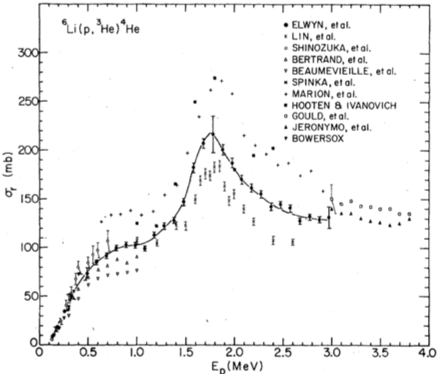
On the Incompatibility of Lin and Elwyn data
Dataset | Chisq/pts | av norm | sys error %
Elwyn_pa.dat | 4.317 | 1.133 | 9
Lin_pa.dat | 3.885 | 1.305 | 10
My fitted norms are larger than the
started systematic errors. Elwyn: 13% > 9% !
Lin: 31% > 10% !
The figure shows these data sets are incompatible.
Need some large scaling factors.
Lin
Elwyn
Fig 7 from Elwyn (1979) paper

Slide 21
Review of Fit
Using ferdinand.py:
Make a GNDS or ENDF file of the R-matrix parameters
Pointwise reconstruction of elastic and non-elastic cross-sections and distributions, so Fudge .evaluate api works.
Use validateWithX4plots.py:
Extract data from EXFOR independently
Compare with evaluate-d ENDF cross-sections
Make graphs, one for each EXFOR subentry.
At least for ³He incident on ⁴He.
See next 6 slides to compare with compatible data from EXFOR
(but without normalization factors or energy shifts!)

Slide 22
Review ³He + ⁴He elastic scattering from EXFOR

Slide 23
Review ³He + ⁴He elastic scattering (2)

Slide 24
Review ³He + ⁴He → ¹H + ⁶Li from EXFOR
More work needed for higher
H1 energies!
They are above original
Test1b range.

Slide 25
Review ¹H + ⁶Li elastic scattering (1)
More work needed for higher H1 energies!

Slide 26
Review ¹H + ⁶Li elastic scattering (2)

Slide 27
Review ¹H + ⁶Li → ⁴He + ³He from EXFOR
EXFOR only has ³He + ⁴He
Even when the Lin data is listed as (3-LI-6(P,HE3)2-HE-4,DA), but has title: “Cross Section Measurements for the ⁶Li(p,α)³He Reaction in the Proton Energy Range 1.0 - 2.6 MeV”

Slide 28
Review ¹H + ⁶Li → ⁴He + ³He from EXFOR

Slide 29
Refitting with higher energy p+Li6 data
Include more data:
Spiger A1094007 : (h,p)
Tombrello A1295005 : (h,p)
McCray A1410002 : p elastic
Search again for χ² minimum in Brune basis
Only subthreshold constrained pole energies.
Find χ²/dof = 1.55
Check transformation to Brune basis (do not allow R amplitudes to become too large)

Slide 30
Spiger A1094007 : (h,p)

Slide 31
Tombrello A1295005 : (h,p)

Slide 32
McCray A1410002 : p elastic

Slide 33
Before: ³He + ⁴He → ¹H + ⁶Li from EXFOR
p elastic

Slide 34
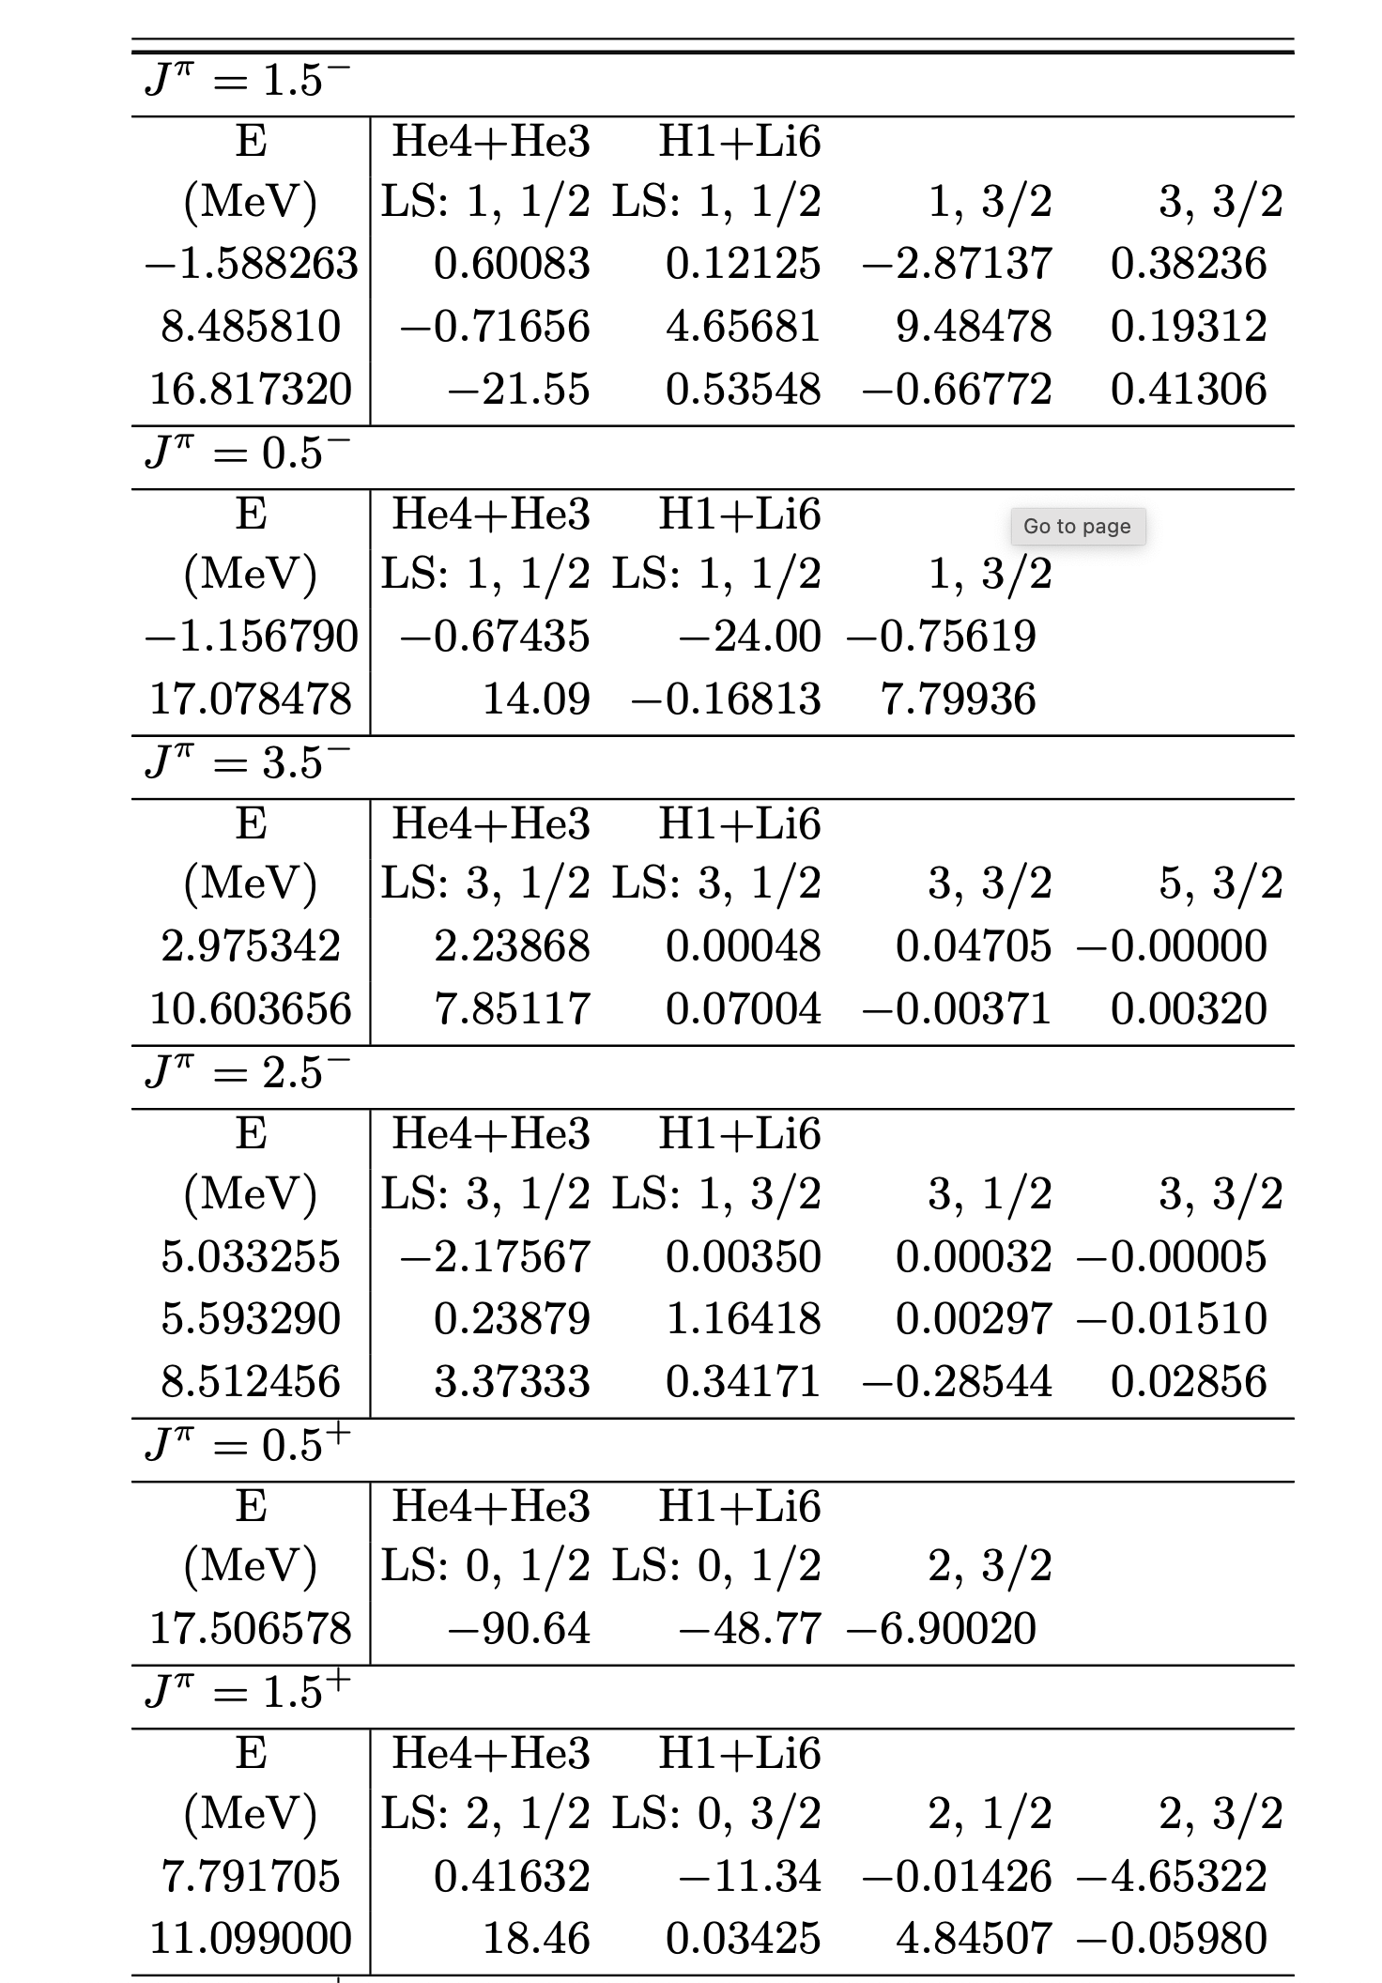
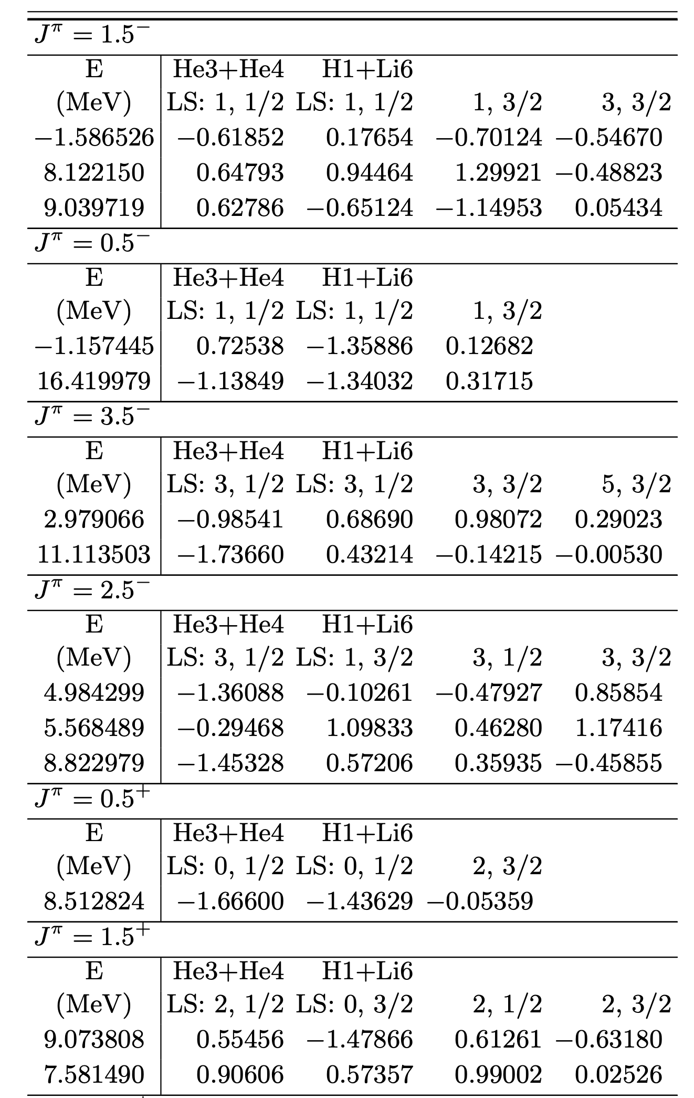
New parameters (Brune basis): mostly shifted!
old
new

Slide 35
Still to do
Include
Li6(3⁺) excited state: has been measured
He3 + He4 → Be7 + γ
Also? He3 + He4 → Be7(1/2⁻) + γ (γ decays 0.429 MeV → gs) (like n+Li6 capture)
Evaluate data sets which appear to be discrepant
Include any further LANL data
Validate fits with all our codes (using https://github.com/LLNL/ferdinand )
Submit v2 to CSEWG for ENDF/B-VIII.1/beta2

